Slide 1
Vlog 1
By The 4 Codesmen - Abraham, Dhruv, Dinesh, Favor
ENSE 400/477(2022-2023): SSE Capstone

Slide 2
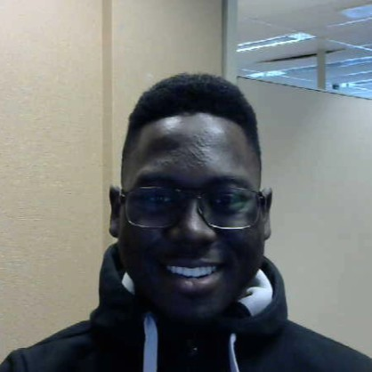
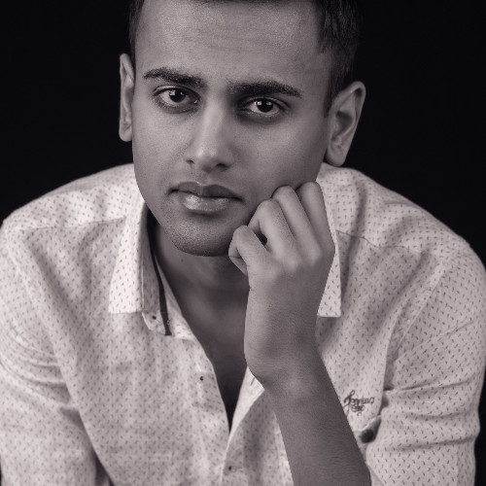
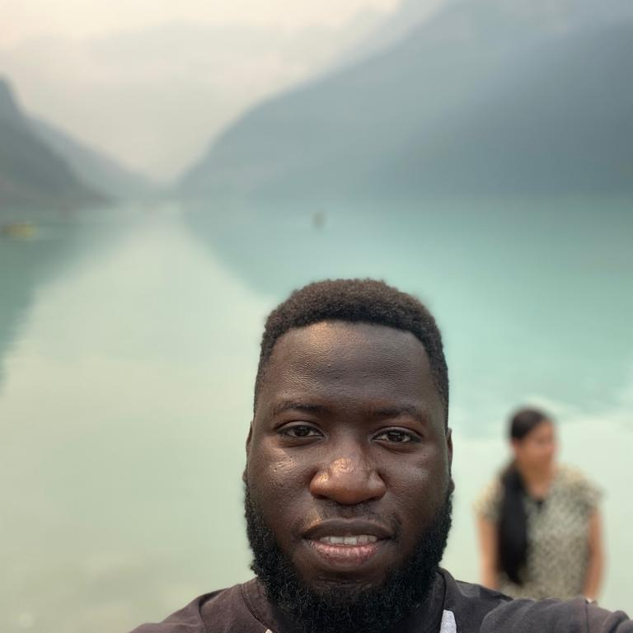
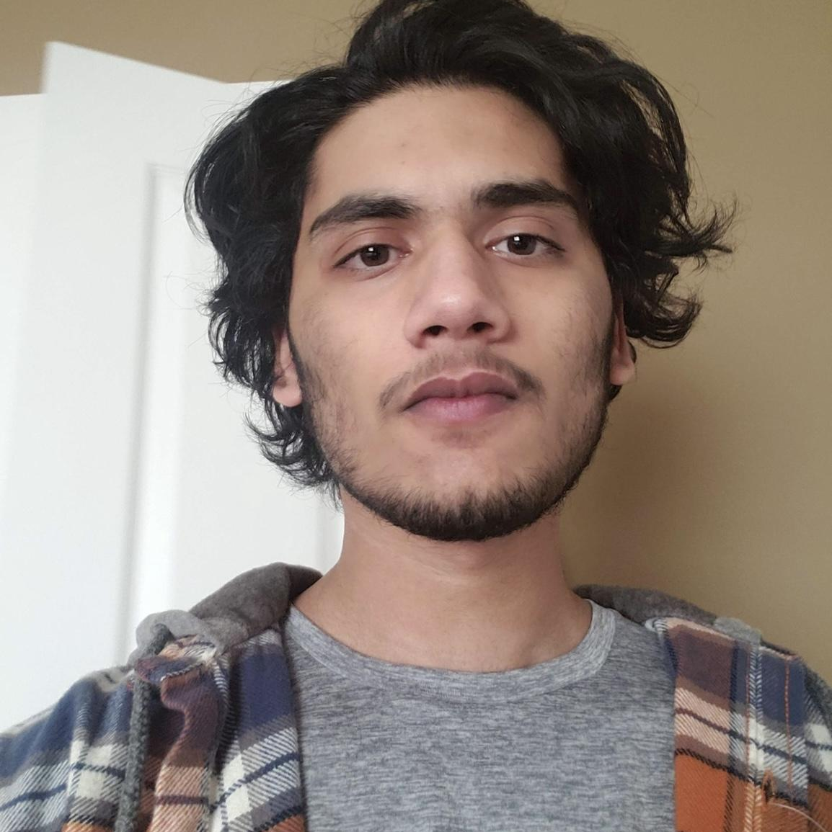
Team Introduction
Favor Fasunwon Frontend Developer and UI/UX Designer
Dhruv Modi Team Lead and Backend Developer
Abraham Mugerwa Frontend Developer Documentation Manager
Dinesh Dalip JSoftware Architect and Backend Developer
Notes:
Hello we are the 4 codesmen,
Abraham: Frontend Developer and Documentation Manager
Dhruv: Team Lead and Backend Developer
Dinesh: Software Architect and Backend Developer
Favor: Frontend Developer and UI/UX Designer

Slide 3
Project background & business need/opportunity
For our capstone project we are building a web application for U of R residence that allows U of R Residence Students:
To connect with each other
Make friends
Help each other out academically [Build a community]
Be part of the Residence life [Stay updated about events]
To decrease/eliminate the Social Gap [Less Isolation and Increased Socialization]
Current Situation
Currently U of R Residence does not have a dynamic application that brings U of R Students together. There is an application for U of R Residence however it is outdated and requires a major upgrade.
Opportunity
Build an application for U of R residence that
Replaces the old application
Enhances the experience of living on campus.
Future Opportunity
Go beyond U of R and share this digital ecosystem with other University Residences as well.
Notes:
For our capstone project we are building a web application for U of R residence. We are building a digital platform that allows U of R Residence Students to connect with each other, make friends, help each other out academically, and be part of the residence life. There is no doubt that living on residence is lively but this is not the case for all students. Living on Residence for some students could also bring isolation and minor to zero socialization, especially for the students who are international and/or are not from Saskatchewan/Regina, this also includes domestic students. We have a solution to this problem, it does not matter where the students are from and how strong their network is, with this application we can decrease that social gap and give a digital platform for students to broaden their network at U of R [U of R Residence and U of R]. With our web application students will also be updated about events that are taking place at U of R Residence. This is how we will be innovating the Campus Life for Students and make living on campus fun and social for all students.
Currently U of R Residence does not have a dynamic application that brings U of R Students together. There is an application for U of R Residence however it is outdated and requires a major upgrade. We believe this is an opportunity for us to build an application for U of R residence that not only replaces the old application but also enhances the experience of living on campus. Not just U of R, we believe that with this application we have the opportunity to go beyond U of R and share this digital ecosystem with other university residence as well.

Slide 4
Reason
Improving the campus experience
Connecting students going through the same experiences
Increasing social engagement and interaction
Updating Residents on things to do around them
Reducing the fear of the unknown

Slide 5
Impact
We hope this application encourages users to continue to engage in an atmosphere of interaction making life at post-secondary smooth and fun

Slide 6
Who
Our audience are the students in residence at the University of Regina located in Regina, SK, Canada.
As of this first Minimum Viable Product, we hope to reach the residence at the University of Regina and towards future viable productions of this application, we hope to reach all Universities in Canada who have residence.

Slide 7
Constraints and limitations
Lack of knowledge
Limited user involvement
Scope vs time
Different perspectives about project envisioned by team members
Features cannot be implemented due to restrictions by University of Regina l

Slide 8
THANKS!
Thanks for listening

Slide 9
Credits
Special thanks to all the people who made and released these awesome resources for free:
Presentation template by SlidesCarnival
Illustrations by Sergei Tikhonov
Photographs by Unsplash

